Slide 1
Music Store Database Project By Arnab Kumar
Tools Used : Postgres SQL

Slide 2
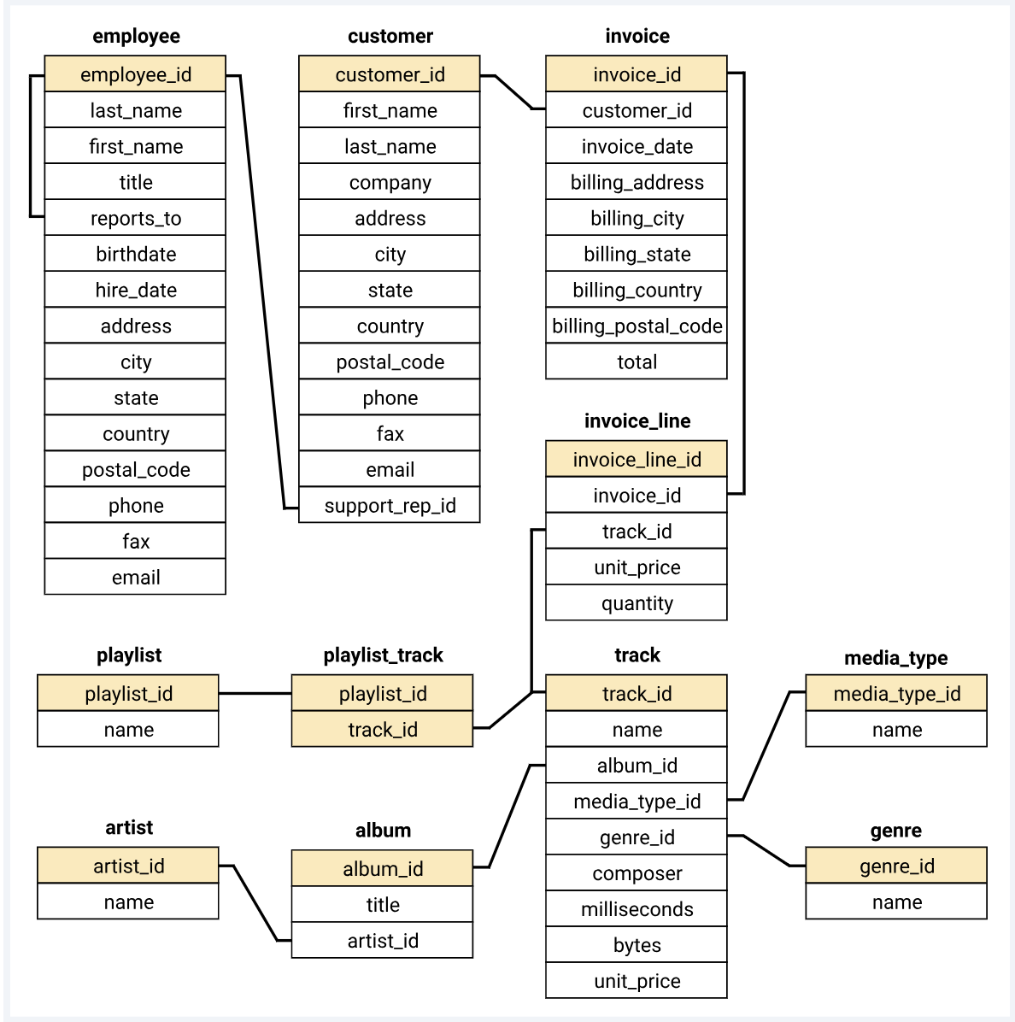
Schema Diagram

Slide 3
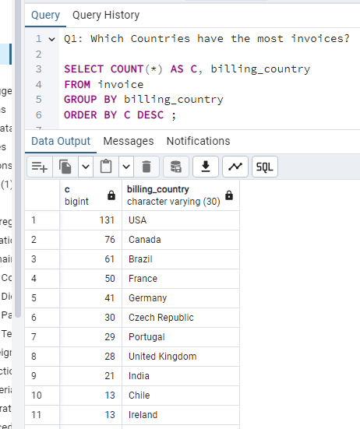
To Solve this question I used basic count function & grouped them by the billing_country.

Slide 4
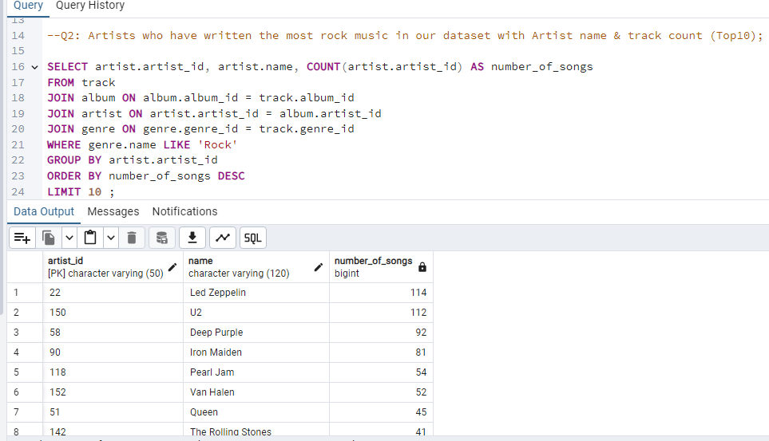
For this question I used the Join function to link 3 tables through the primary keys

Slide 5
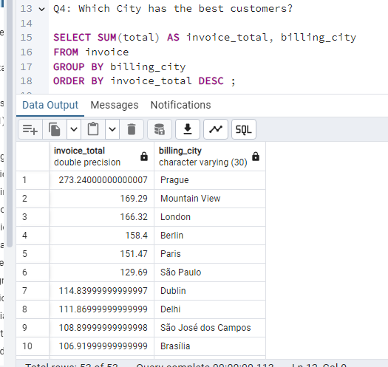
Interestingly even though USA as a country had the most invoices generated Prague had the most invoices in City category with Mountain View, California coming at 2nd place.

Slide 6
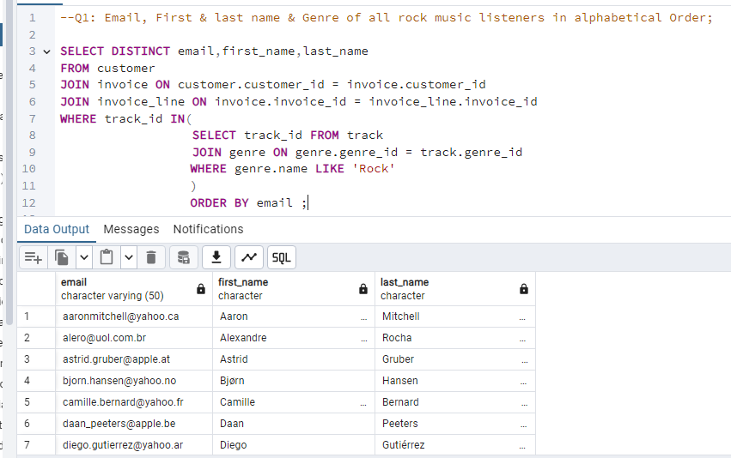
In this question I used the distinct function to filter out any duplicate records & then I used an Inner query with the WHERE statement to get only ‘ROCK’ genre

Slide 7
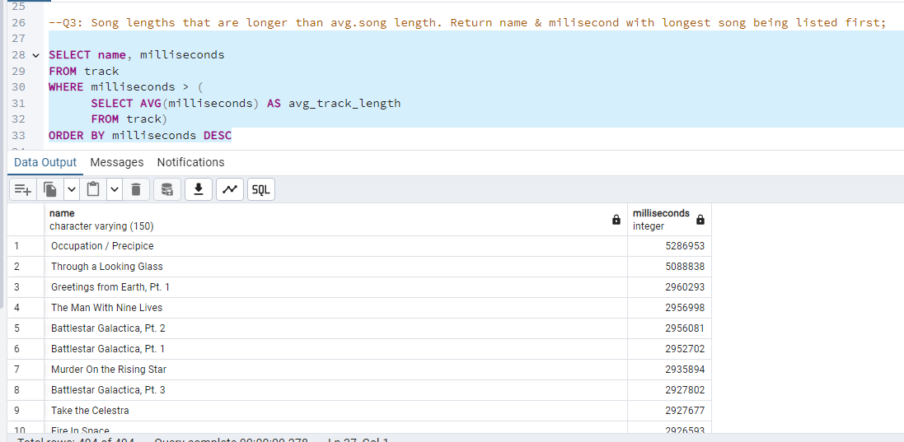
In this question I used an Inner query to first find out avg song length of every song in the database & then used that as a reference to find out the longest song.

Slide 8
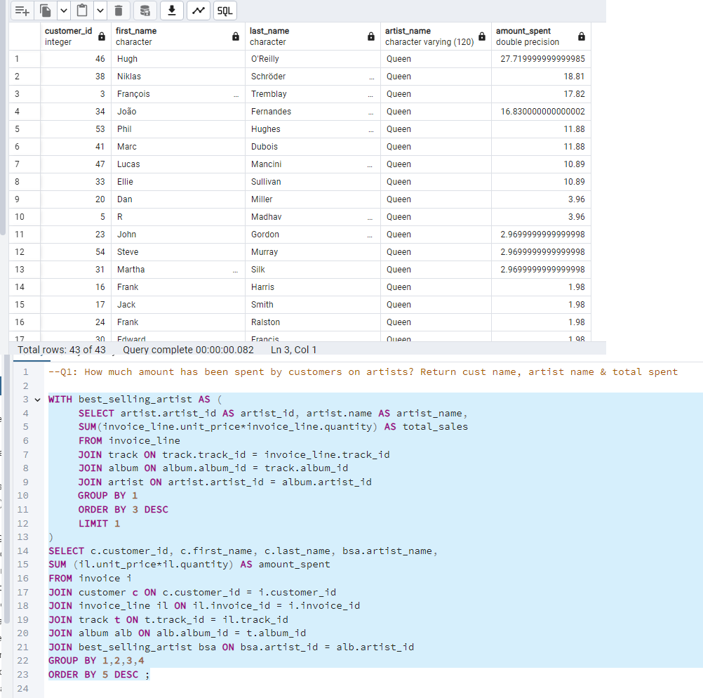
I used CTE to create a temporary table to get the results needed.

Slide 9
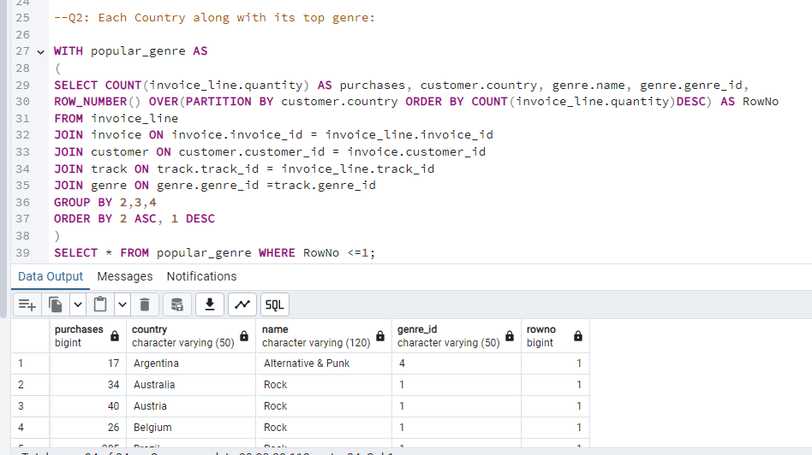
To get the best selling genre from each country I used Row_number & interestingly other than Argentina in every other country Rock was the highest selling genre of Music.

Slide 10
